Slide 1
KILLER DRONES
MII DRON - INGENIA SE
03/12/2018

Slide 2


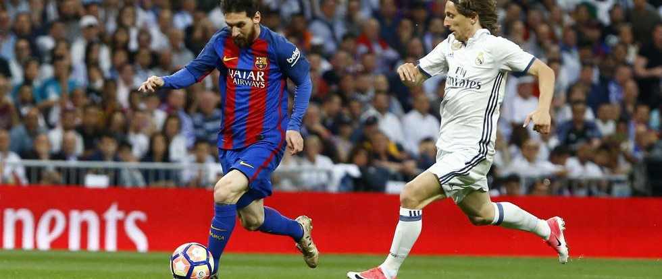
Who am I?
Jaime de los Santos
Communication Manager

Slide 3
Table of Contents
1. Introduction
2. Reality or fiction?
3. Impact
4. Ethical Debate
Notes:
El uso de la inteligencia artificial en drones, los capacita para ser armas con capacidad de decisión sobre su objetivo…

Slide 4
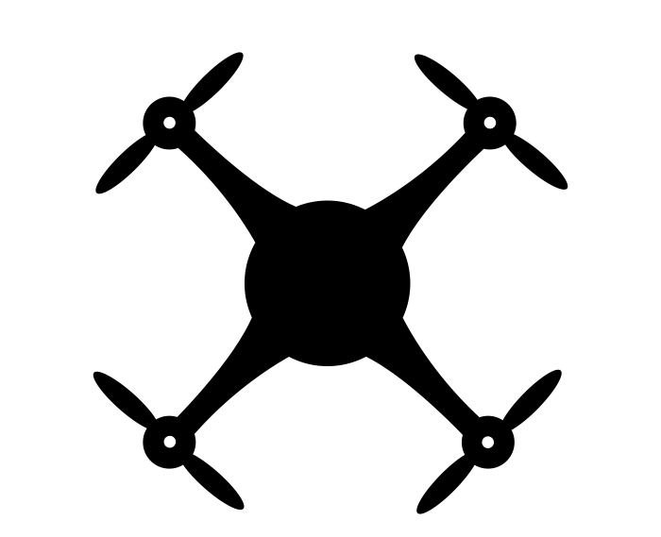

Why drones?
Introduction
1- Investment
2- Autonomous flight
3- Versatility
Unmanned Aerial Vehicle
MILITARY USE
Notes:
Killer drones (ideas):
NO OLVIDAR PÚBLICO “COMÚN”
Drones are unmanned aerial vehicles (UAVs) that can be controlled by pilots from the ground or even fly autonomously. This has led to the idea of using them as a weapon since there is no risk to the “attacker”.
IoT is being weaponized. The same sensors, networks and real-time data analysis used monitoring classrooms can morph into weapons for targeted killing.
The killer drone concept can refer to different types of drones, some of which have already begun to be used. Others suggest the idea of its possibility in the not too distant future, which places us in a position of alarm.

Slide 5
Types of Drones
Introduction
CLASSIFICATION BASED ON FUNCTIONS
UAVs can also be classified based on the specific roles they are meant to play in particular military operations. Based on this we have the following UAVs:
Target and decoy UAVs – these can be used to provide ground as well as aerial gunnery at a target which simulates an enemy missile or aircraft.
Reconnaissance UAVs – these are used to provide intelligence at the battlefield.
Combat UAVs – have been used to provide attack capability for some high-risk missions.
Research and Development UAVs – have been used to further develop UAV technologies that can be integrated into UAVs that have been deployed in the field.
Civil and Commercial UAVs – these are those that have been designed to be used in civil and commercial applications.

Slide 6

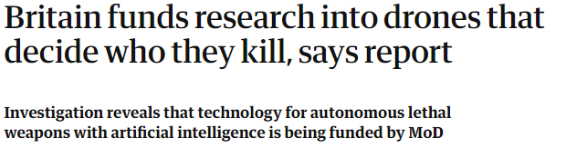
Intelligent Drones?
Reality or fiction?
Technological growth
sensors
networks
monitoring
real-time data analysis
IoT
https://www.theguardian.com/world/2018/nov/10/autonomous-drones-that-decide-who-they-kill-britain-funds-research (Nov 2018)
Notes:
El uso de la inteligencia artificial en drones, los capacita para ser armas con capacidad de decisión sobre su objetivo…
The Ministry of Defence has claimed that unmanned aircraft “will eventually have the ability to independently locate and attack mobile targets, with appropriate proportionality and discrimination, but probably not much before 2030.”
A spokesman for the MoD said: “There is no intent within the MOD to develop weapon systems that operate entirely without human input. Our weapons will always be under human control as an absolute guarantee of oversight, authority and accountability.”

Slide 7

Future of Killer Drones
Reality or fiction?
Additional information:
https://spectrum.ieee.org/automaton/robotics/military-robots/why-you-shouldnt-fear-slaughterbots
Notes:
Hay que comentar que el avance y la investigación en estas tecnologías, convertirán a los drones en un arma de uso común por el ejército y las autoridades.
En esta película, llamada Slaughterbots, se presenta una futuro donde enjambres asesinos de drones caen en manos de terroristas y siembran el caos. Es una tecnología que realmente ya se puede implementar, porque no se necesita nada demasiado complejo, pero que aún no se ha llevado a la realidad.
Hay que echarle un poco de imaginación jaimito.

Slide 8
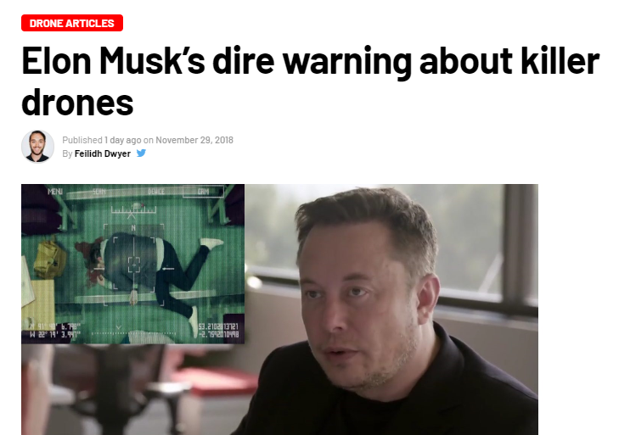
Expert’s opinion
Reality or fiction?
‘You could make a swarm of assassin drones for very little money. By just taking the face I.D. chip that’s used in cell phones, and having a small explosive charge and a standard drone, and just have it do a grid sweep of the building until they find the person they’re looking for, ram into them and explode. You could do that right now… No new technology is needed.’
Elon Musk
Notes:
The central premise of “Slaughterbots” is that in the future militaries will build autonomous microdrones with shaped charges that can fly up to someone’s head and detonate an explosive, killing the person.
In the film, these “slaughterbots” quickly fall into the hands of terrorists, resulting in mass killings worldwide.
In testimony to the all-party parliamentary group on drones, Professor Stuart Russell, professor of electrical
engineering and computer sciences at the University of California, claimed that an improvised small-armed autonomous drone was something that a competent group could develop and build in large numbers within 18 months to two years.
Researchers at Arizona State University have catalogued 273 weapon systems around the world which already have some autonomous functions. Nineteen of the systems are described as unmanned aerial vehicles.

Slide 9

War on Terror
Impact
Military application
UAVs releasing missiles or bombs
No troops members lost
“To date, only three countries, the USA, the UK and Israel, are known to have used armed drones, and all these have made clear their intentions to further expand their drone fleets.” (https://waronwant.org/killerdrones)
A total of 563 strikes, largely by drones, targeted Pakistan, Somalia and Yemen during Obama’s two terms
(https://www.thebureauinvestigates.com/stories/2017-01-17/obamas-covert-drone-war-in-numbers-ten-times-more-strikes-than-bush )
Notes:
Killer drones (ideas):
NO OLVIDAR PÚBLICO “COMÚN”
One of its main areas of application is the military, being already present in armed conflicts. In this sense, these drones are UAVs that release missiles or bombs in the same way as before a manned aerial vehicle did. In this case, the armies eliminate the risk of their pilots being shot down and losing members of their troops. To date, only three countries, the USA, the UK and Israel, are known to have used armed drones, and all these have made clear their intentions to further expand their drone fleets. The impact of drone war on civilians living in Afghanistan and Pakistan has been devastating, with many civilian casualties and the constant threat of attack from drones circling the skies for up to 17 hours at a time. In addition to the death toll, the psychological impact of living under constant surveillance, never knowing when the next strike will come, is a serious consideration.
This is a reality today as a result of all the possibilities or tools offered by high technological growth. However, we must be responsible for how we use this development and the impact it could bring on.

Slide 10
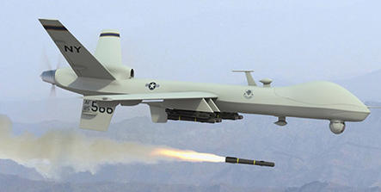
Precision Issues
Impact
High death toll
‘Strikes in Pakistan peaked in 2010, with 128 CIA drone attacks and at least 89 civilians killed.’
Civilians in Afghanistan and Pakistan were devastated
Constant threat
Drones flying for up to 17h at a time
Living under surveillance - Uncertainty
Notes:
2014 41 men targeted but 1147 people killed. 28 unknown people for every ‘bad guy’

Slide 11
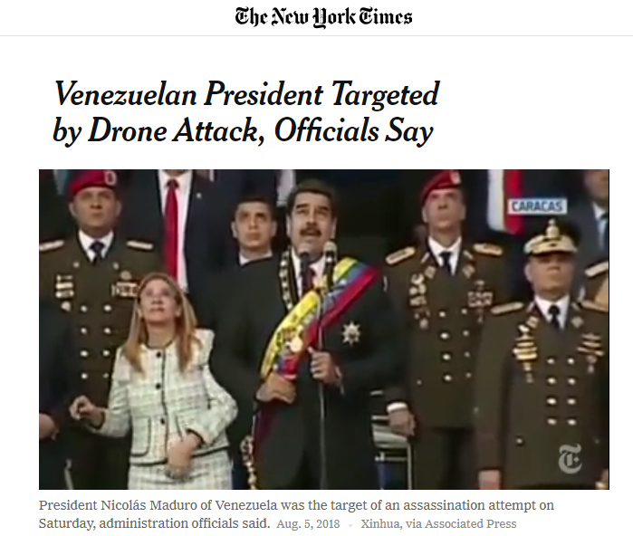
Famous Targets
Impact
Notes:
Agosto 2018

Slide 12
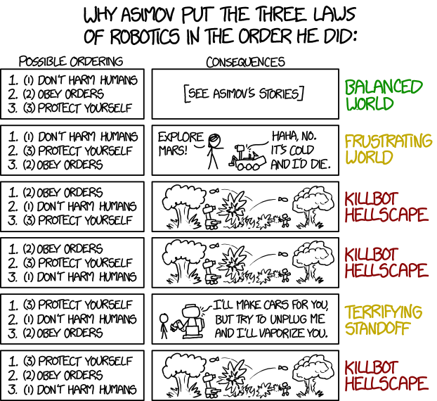
Ideal Robots Laws (1942)
Ethical debate
Isaac Asimov's "Three Laws of Robotics" (1942)
A robot may not injure a human being or, through inaction, allow a human being to come to harm.
A robot must obey orders given it by human beings except where such orders would conflict with the First Law.
A robot must protect its own existence as long as such protection does not conflict with the First or Second Law.

Slide 13
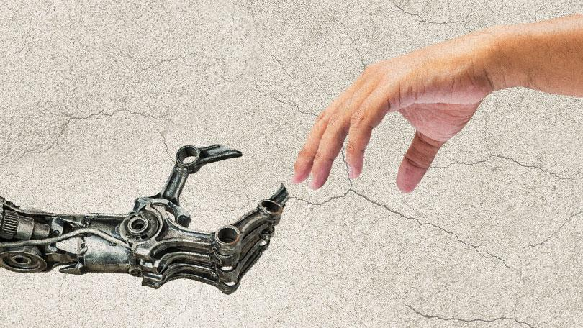
Ideal Robots Laws (2011)
Ethical debate
Engineering and Physical Sciences Research Council (EPSRC) and the Arts and Humanities Research Council (AHRC) of Great Britain (2011)
Robots should not be designed solely or primarily to kill or harm humans.
Humans, not robots, are responsible agents. Robots are tools designed to achieve human goals.
Robots should be designed in ways that assure their safety and security.
Robots are artifacts; they should not be designed to exploit vulnerable users by evoking an emotional response or dependency. It should always be possible to tell a robot from a human.
It should always be possible to find out who is legally responsible for a robot.

Slide 14

Human responsibility?
Ethical debate
Critics worry for taking humans out of the technology loop of decisions.
‘We’re not anti-robotics or anti-autonomy. We just say that, once you reach a stage where a platform is weaponized, you have to maintain meaningful human control.’
Stephen Goose, Human Rights Watch
Notes:
ethical debate:
-Lo que ya está escrito en la diapo de la capacidad de decisión de los drones ellos solitos
-The way this technology is used: no solo la preocupación por la toma de decisiones de los drones por su cuenta, sino también la preocupación por lo que implica que exista esta tecnología, porque puede ser usada para cosas éticamente incorrectas (p.ej terrorismo o yo que se).
-avance más rápido de las tecnologías que de su regulación (legislación… mejor escucha el audio de whatsapp q me explico mejor)

